Slide 1
PS6 tips

Slide 2
Practical method selection
These two methods are not often used in real-world applications:
Hough transform (especially circle) of OpenCV
Template matching for shape matching

Slide 3
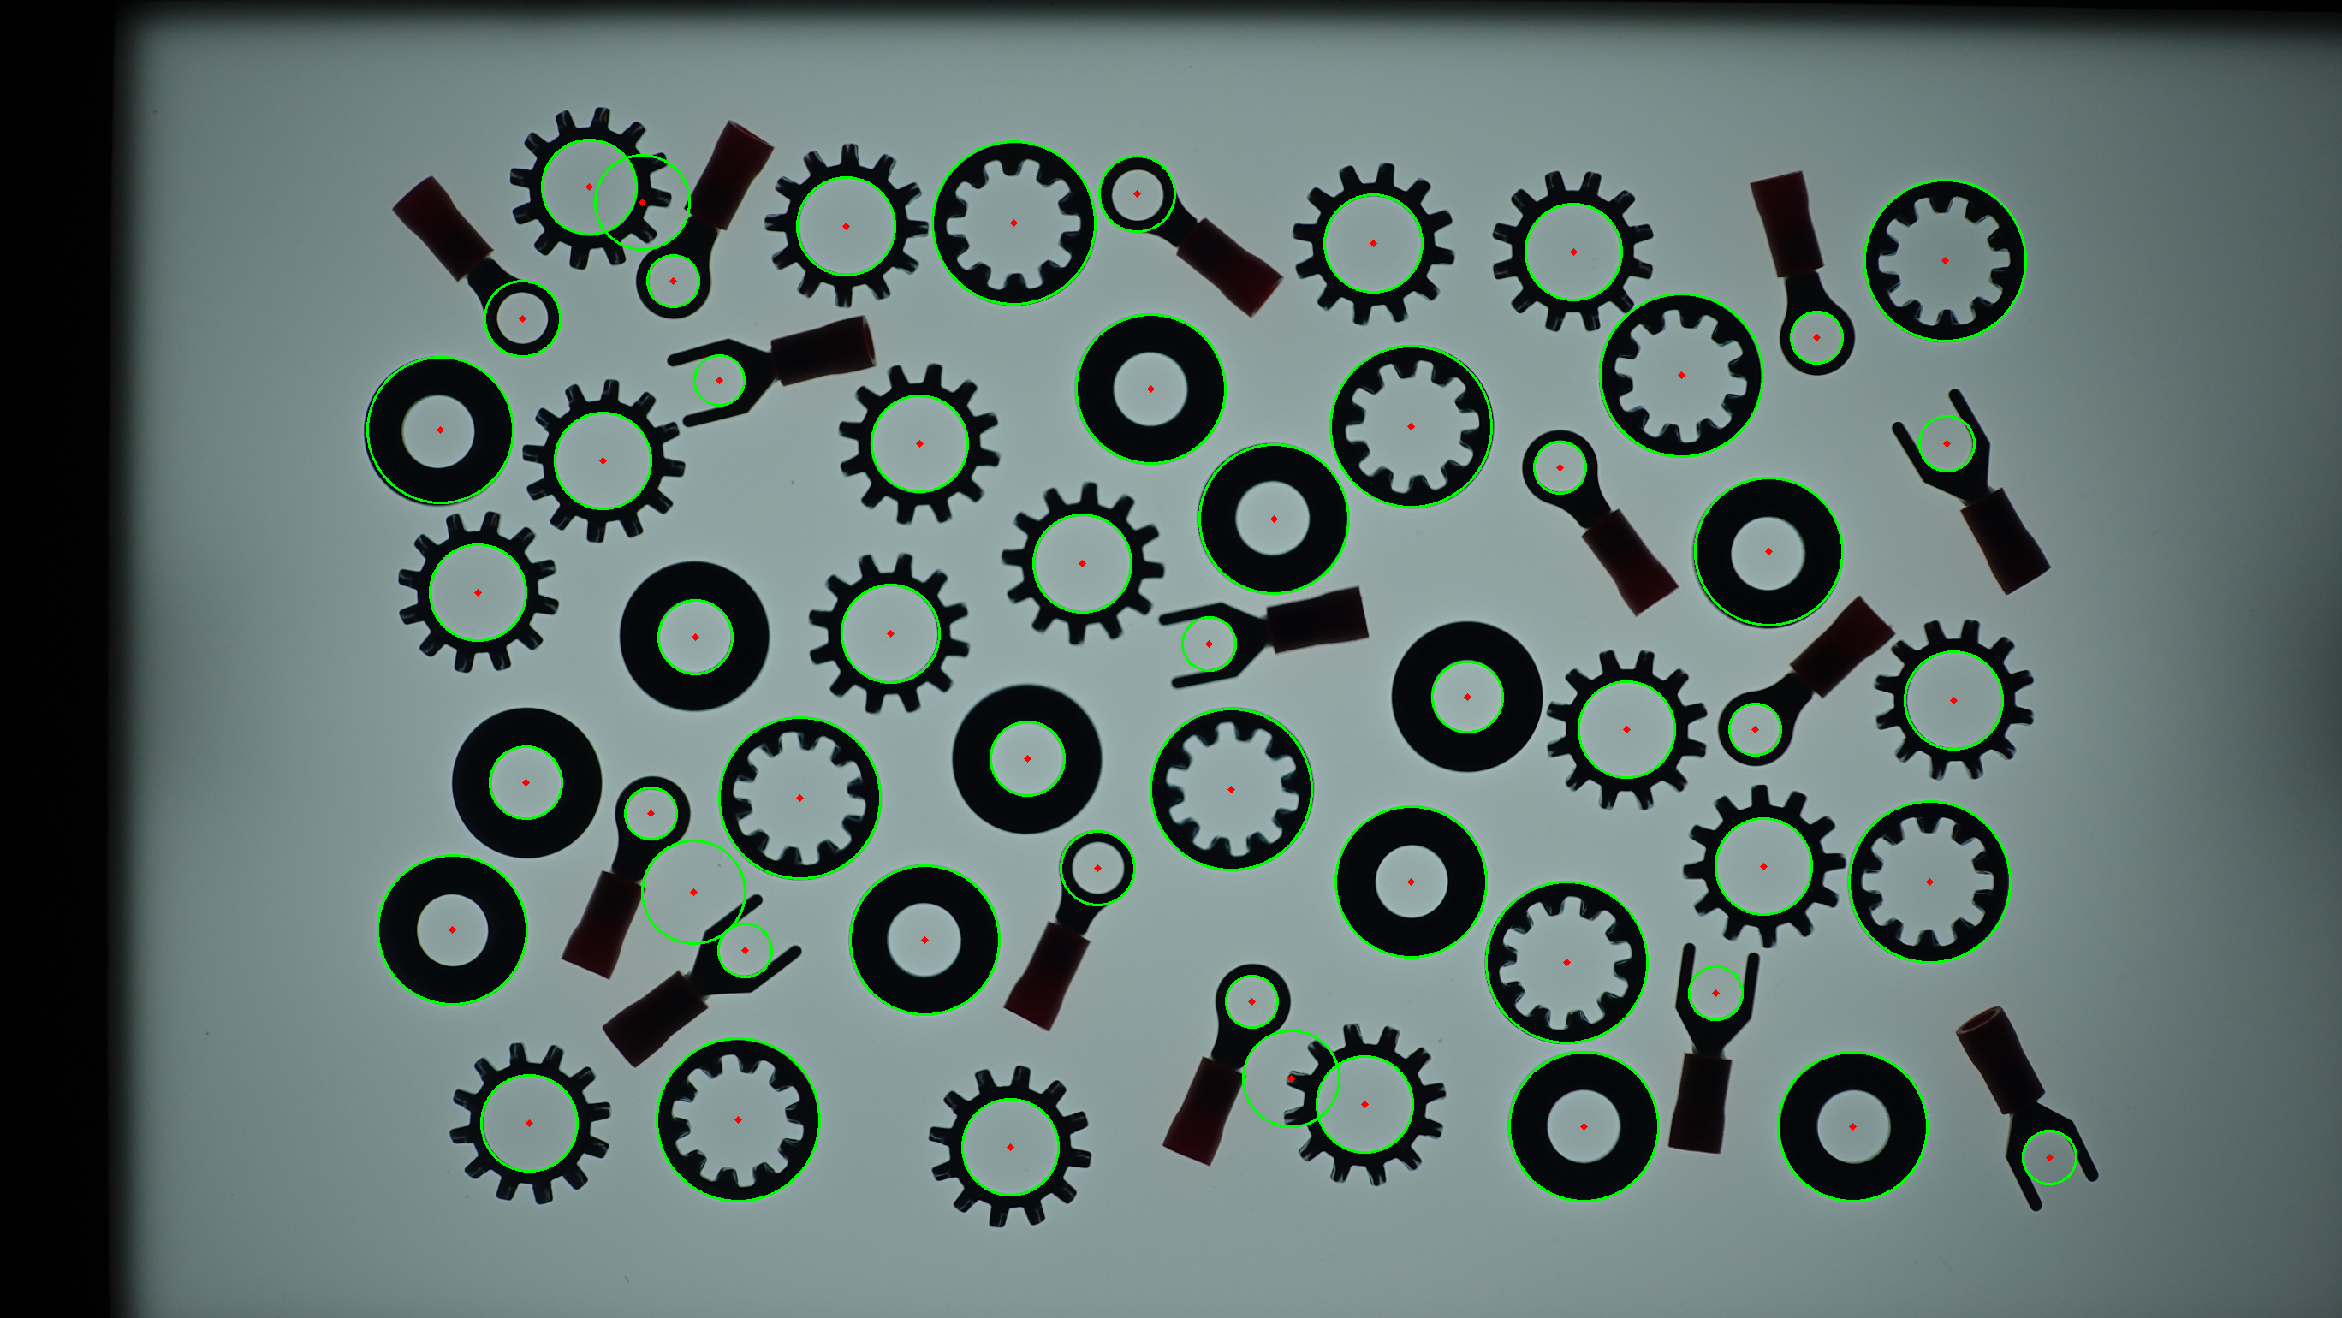
Circle/Line Detection
Hough transform algorithm
It is difficult to use the OpenCV implementation
Same center circle
Circle size needs to be specified.
Separate circle/line matching (noise)
Practical solution
Contour Detection
Length (2πr)
Area (πr²)

Slide 4
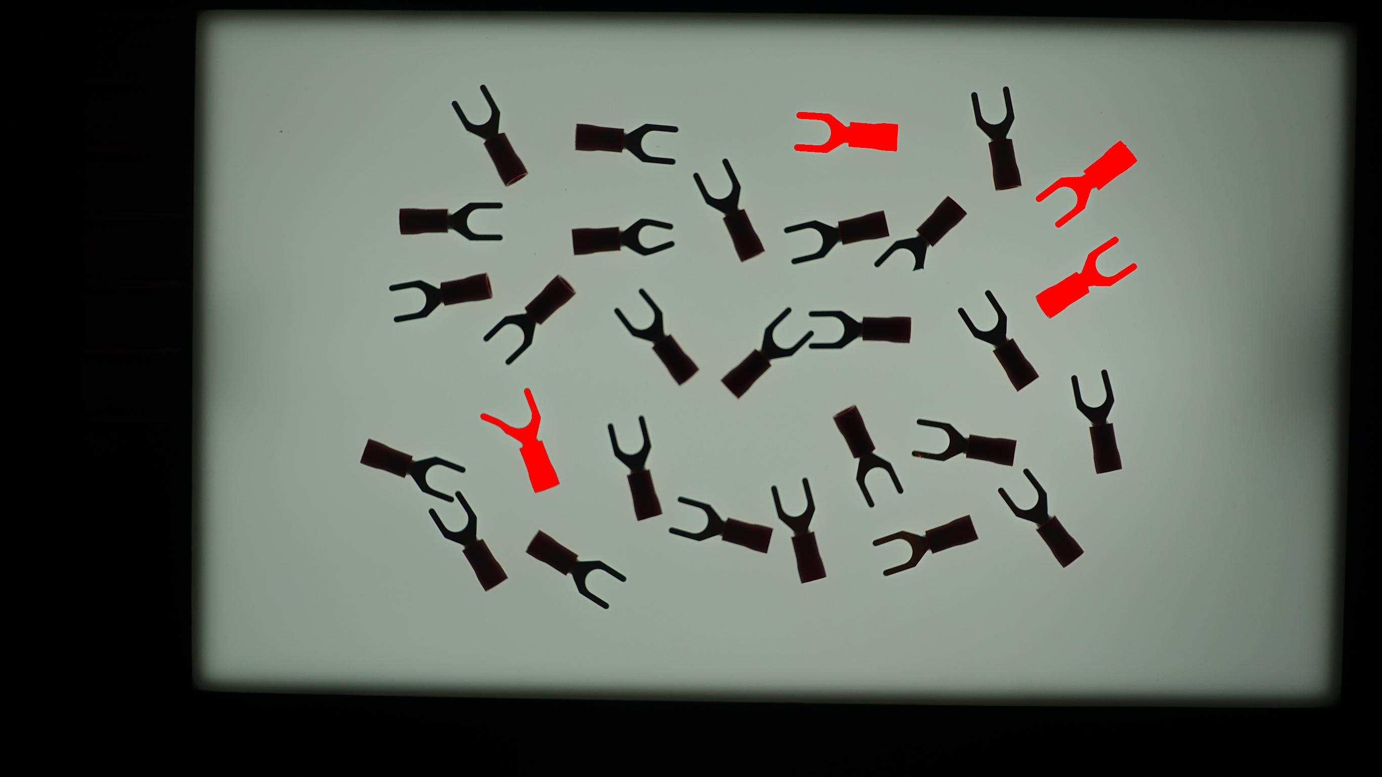
Template matching limitation (defective parts)
Template matching requirements
Same/similar size
Better on grayscale or pattern
Pattern matching not shape matching, but region similarity
Binary image does not suit
White/Black background also match.
Size and Orientation invariant methods are better for shape similarity check.

Slide 5
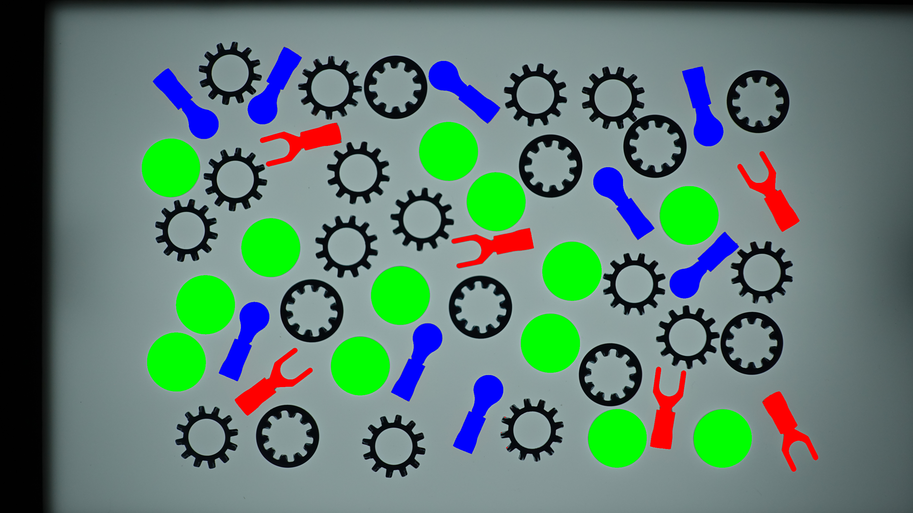
3parts.py
Current Status
Separation (not complete) of image
Opening (E->D), multiple?
Number of contour lines
Bounding box shape
You need to complete in/out gear separation

